Slide 1
BOOSTING ALGORITHMS-REGRESSION
1.Ada Boost
2.XG Boosting
3.LG Boosting

Slide 2
1.Ada Boost
INTRODUCTION
An AdaBoost regressor is a meta-estimator that begins by fitting a regressor on the original dataset and then fits additional copies of the regressor on the same dataset but where the weights of instances are adjusted according to the error of the current prediction. As such, subsequent regressors focus more on difficult cases.

Slide 3
Applications
Quantitative Prediction: Suitable for any regression task aiming to predict a numeric value, such as house prices, temperature forecasts, or stock market trends.
Model Stacking: Can be used as part of a model stacking ensemble, where the outputs of several models are input into another model to improve predictions.
Feature Importance Analysis: Similar to classification, AdaBoost regressor can be used to highlight the features most relevant to predicting the target variable.
AdaBoost for regression adapts the boosting methodology to fit continuous target values, rather than categorical ones. The principle remains the same: sequentially apply weak regressor models, adjust their influence on the final prediction based on their error, and thereby improve the robustness of the prediction over iterations.

Slide 4
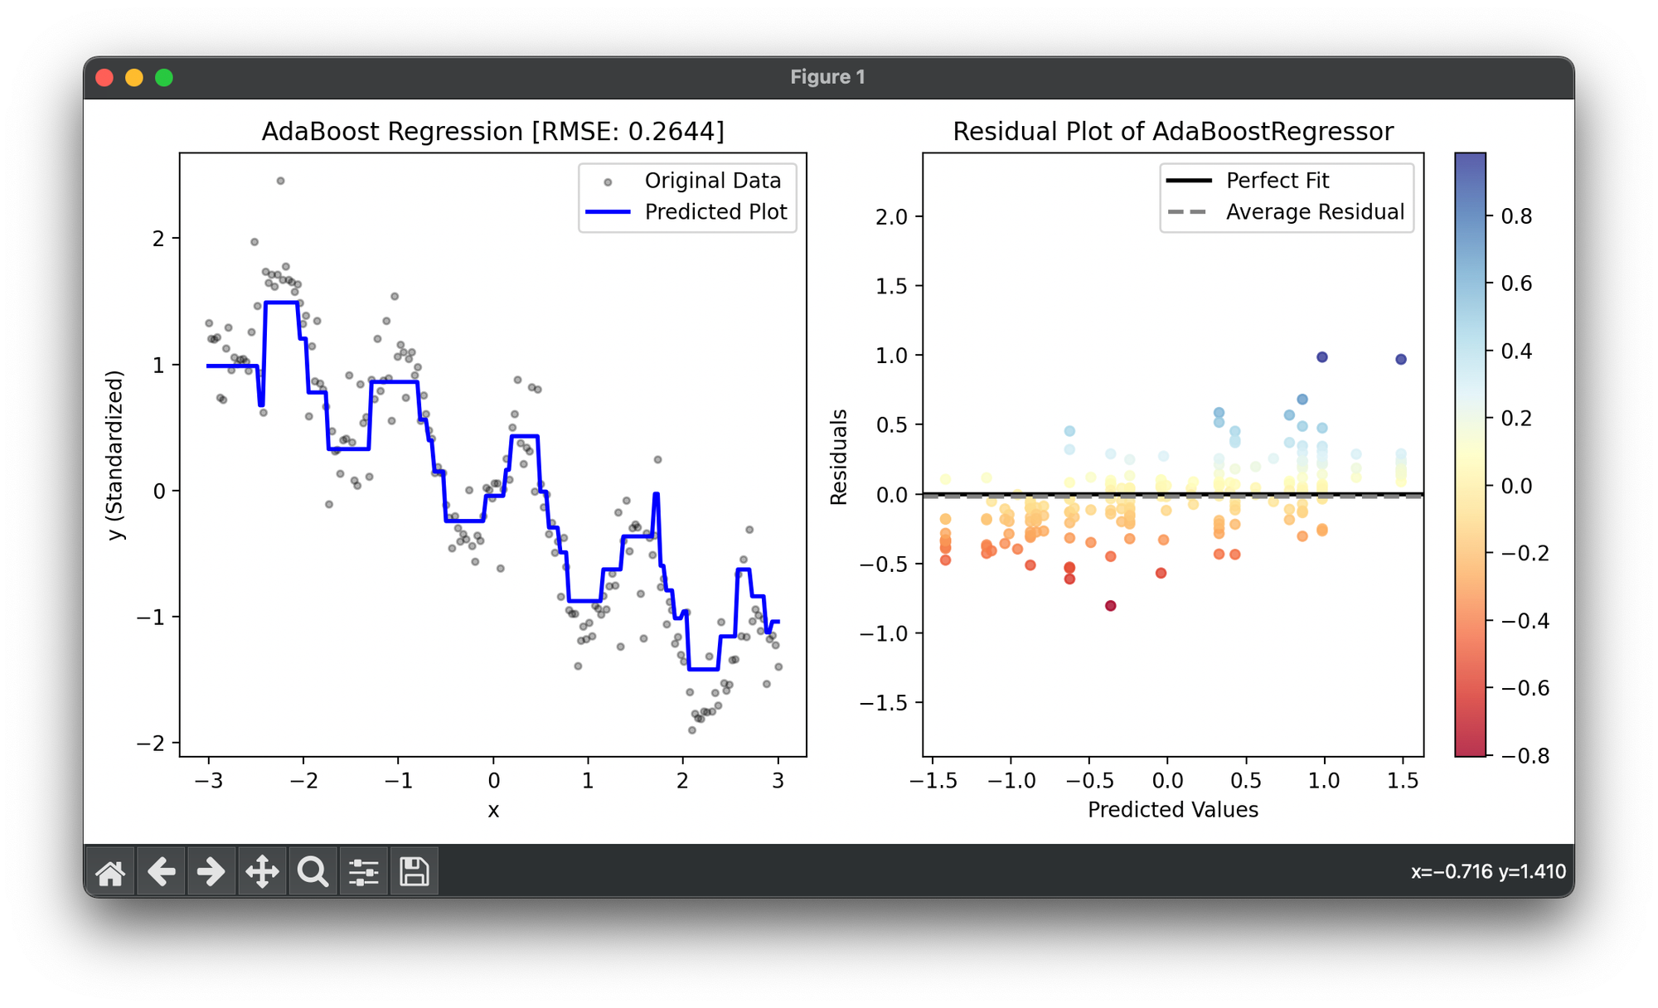

Slide 5
2.XG Boosting
INTRODUCTION
XGBoost is a supervised machine learning method for classification and regression and is used by the Train Using AutoML tool. XGBoost is short for extreme gradient boosting. This method is based on decision trees and improves on other methods such as random forest and gradient boost.

Slide 6
Advantages: Effective with large data sets. Tree algorithms such as XGBoost and Random Fwith segregated clusters.
Disadvantagesorest do not need normalized features and work well if the data is nonlinear, non-monotonic, or : Tree algorithms such as XGBoost and Random Forest can over-fit the data, especially if the trees are too deep with noisy data

Slide 7
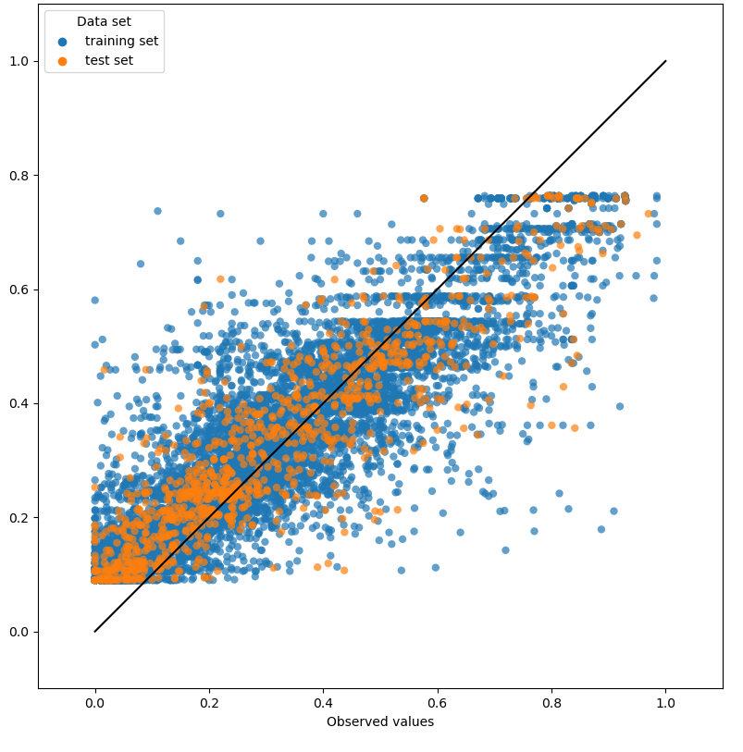

Slide 8
3.LG Boosting
INTRODUCTION
LightGBM is an open-source, distributed, high-performance gradient boosting framework developed by Microsoft. It is designed for efficiency, scalability, and accuracy. It is based on decision trees designed to improve model efficiency and reduce memory usage. It incorporates several novel techniques, including Gradient-based One-Side Sampling (GOSS), which selectively retains instances with large gradients during training to optimize memory usage and training time. Additionally, LightGBM employs histogram-based algorithms for efficient tree construction. These techniques, along with optimizations like leaf-wise tree growth and efficient data storage formats, contribute to LightGBM’s efficiency and give it a competitive edge over other gradient boosting frameworks.

Slide 9
Advantages of the LightGBM
The advantages of the LightGBM model include:
Faster Speed and Higher Accuracy: LightGBM algorithm offers faster training times and higher accuracy compared to other gradient boosting algorithms, making it suitable for large-scale datasets and time-sensitive applications.
Lower Memory Usage: LightGBM is designed to optimize memory usage efficiently, allowing it to handle large datasets with minimal memory requirements, which can lead to cost savings and improved performance.
Better Accuracy: LightGBM’s innovative algorithms, such as leaf-wise tree growth and histogram-based learning, contribute to better accuracy in model predictions, resulting in more reliable and precise outcomes.
Support for Parallel and Distributed GPU Learning: LightGBM supports parallel training on multi-core CPUs and distributed GPU learning, enabling efficient utilization of computational resources and faster training times for large-scale datasets.
Capability to Handle Large-Scale Data: LightGBM is capable of handling large-scale datasets efficiently, thanks to its optimization techniques and support for parallel processing, making it suitable for big data applications in various industries.

Slide 10
